Slide 1
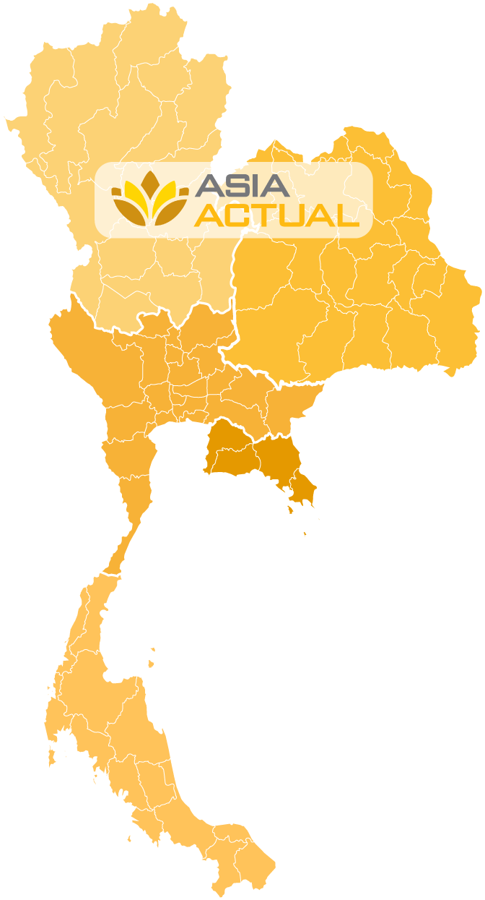
Thailand Sales Performance
Total Targets: OOO hospitals performing OOO procedures
NORTH
Targets: %
Revenue: $_______ ___%
NORTH EAST
Targets: %
Revenue: $_______ ___%
CENTRAL
Targets: %
Revenue: $_______ ___%
EAST
Targets: %
Revenue: $_______ ___%
SOUTH
Targets: %
Revenue: $_______ ___%
Market Assessment Sales Channel Establishment Registration Ownership

